Slide 1
An Outbreak of Investing
New Accounts and the People Who Opened Them
NORC at the University of Chicago
Mark Lush
Manager | Behavioral Scientist
Angela Fontes, Ph. D.
Vice President
Meimeizi Zhu
Data Scientist
FINRA Investor Education Foundation
Olivia Valdes, Ph. D.
Associate Principal Research Analyst
Gary Mottola, Ph. D.
Research Director
Robert Ganem
Senior Program Director
Notes:
Thank FINRA
Have not done any advanced modelling or analysis
Working off raw data

Slide 2
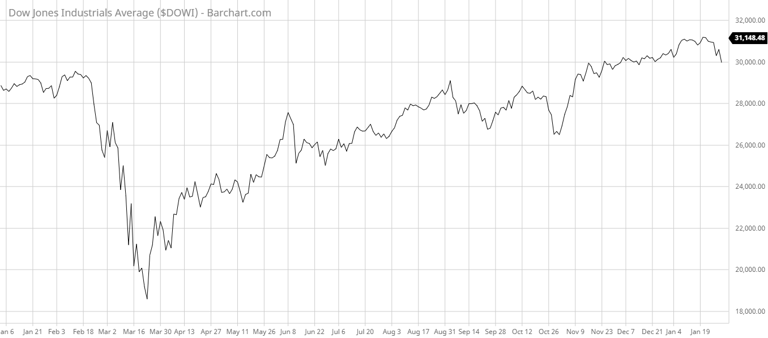
“COVID Crash”
Dow Jones Industrial Average (Jan 1, 2020 – Jan 31, 2021)
18,213 – March 23

Slide 3
Young investors pile into stocks, seeing ‘generational-buying moment’ instead of risk
Coronavirus Turmoil, Free Trades Draw Newbies Into Stock Market
TD Ameritrade posted record retail trading activity
and account growth during 2nd-quarter frenzy
New Accounts Surge at Schwab
New Investors Pile In, Fuel Record Rise In Account Openings, Trading Volumes
Notes:
Historically, investing in the stock market has been dominated by individuals with access to a retirement account through their employer, or with both the
funds and knowledge to open non-employer-sponsored accounts.
More recently, new investment platforms began addressing some of the traditional barriers to investing, such as not knowing how to open an account, limited access to a financial professional, the perception that large sums of money are required to enter the market, and sensitivity to the costs of investing. These platforms, coupled with the market volatility seen in early 2020, appear to be driving a record number of Americans to open new taxable investment accounts. This study seeks to better understand the types of investors entering the market, their motives and decision-making related to investing, and, importantly, how they might differ from more experienced investors.

Slide 4
Methodology
NORC’s Probability-based AmeriSpeak Panel
Online survey fielded between October 26 — November 13
N = 1,291
Notes:
AmeriSpeak is a probability-based panel designed to be representative of the U.S. household population.
Randomly selected U.S. households are sampled using area probability and address-based sampling, with a known,
non-zero probability of selection from the NORC National Sample Frame.
The panel provides sample coverage of approximately 97 percent of the U.S. household population.
Among investors who opened a new account in 2020 in our sample, 66 percent were New Investors who had not previously owned a taxable investment account, making this their first experience with this type of account.

Slide 5
Investor Type by Age
Investor Type by Race/Ethnicity*
Account Balance by Investor Type

Slide 6
Reasons for Opening New Investment Account During 2020, by Age

Slide 7
Primary Reason That Prompted Opening New Account During 2020 by Race/Ethnicity
White Investors | African-American investors | Hispanic / Latino Investors | Asian Investors
Retirement (26%) | Invest with a small amount (35%) | Invest with a small amount (43%) | Retirement (34%)
Invest with a small amount (25%) | Didn’t want to miss opportunity (27%) | Retirement (28%) | Market dips make investing cheaper (28%)
Market dips make investing cheaper (25%) | Friend suggestion (26%) | Goal other than retirement (20%) | Offered a sign-on bonus (24%)
Didn’t want to miss opportunity (22%) | Extra time on my hands (21%) | Market dips make investing cheaper (18%) | Didn’t want to miss opportunity (23%)
Goal other than retirement (19%) | Family member suggestion (20%) | Didn’t want to miss opportunity (17%) | Invest with a small amount (21%)

Slide 8
Primary Reason That Prompted Opening New Account During 2020
Notes:
The three most frequently reported reasons that prompted New Investors to open an account were:
the ability to invest with a small amount of money (35 percent)
wanting to invest for retirement (27 percent),
and dips in the market that made stocks cheaper to buy (26 percent).
Experienced Entrants were similar, but differed slightly, with
investing for a goal other than retirement (25 percent),
wanting to invest for retirement (22 percent), and
the ability to invest with a small amount of money (21 percent) making up their top three reasons for opening a new investment account during 2020.

Slide 9
Account Goals by Investor Type

Slide 10
Information Sources Used When Making Investment Decisions

Slide 11
Mark Lush
Manager | Behavioral Scientist
lush-mark@norc.org

