Slide 1
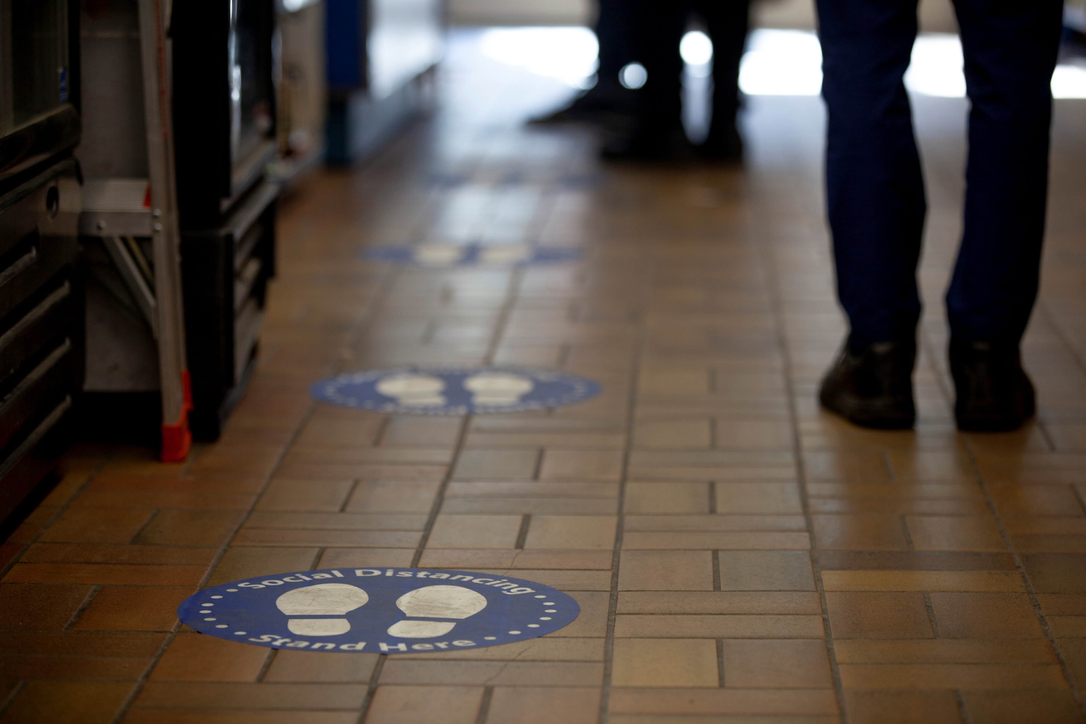
Using Online Panel Surveys to Track Emerging Public Mental Models of COVID-19 Using Open-ended Response Modes
Andrew M. Parker
Keller Scholl
Wändi Bruine de Bruin
Katherine G. Carman
Melissa L. Finucane
CIPHER, March 5, 2021

Slide 2
Acknowledgements & Disclaimer
Effort and data collection on this project was supported by:
Bill & Melinda Gates Foundation
National Institute on Aging (U01AG054580)
NSF RAPID (SES 2027094)
USC’s Schaeffer Center for Health Policy and Economics
Swedish Riksbankens Jubileumsfond Program on Science and Proven Experience
The views expressed are those of the authors and do not necessarily represent the views of these funders.

Slide 3
Background
With COVID-19, people faced a novel threat with limited, uncertain, and changing information
Analogies to familiar diseases can promote understanding and motivation by tapping existing belief networks (i.e., mental models)
Assessing mental models usually starts with in-depth qualitative interviews, small samples, and laborious coding
Notes:
With COVID-19, people faced a novel threat with limited, uncertain, and changing information
Analogies to familiar diseases can promote understanding and motivation by tapping existing belief networks (i.e., mental models)
Early health communications often emphasized comparisons to seasonal influenza
Early newspaper articles associated COVID-19 with pandemic influenza, SARS, MERS, and Ebola (De Ridder, 2020)
But analogies can backfire when associations do not apply to the new context
Mental models should inform risk perception and risk-related behavior
Assessing mental models usually starts with in-depth qualitative interviews, small samples, and laborious coding
Can we get (at least some of) this insight from large, probability-based online panels?

Slide 4
Conceptual Model

Slide 5
Objectives
Combine online panel surveys, natural language processing, and open-ended response modes within large, probability samples and longitudinal designs
Examine which analogies people most commonly generate and how they associate with other beliefs, risk perceptions, and protective behaviors

Slide 6
Used Two Online Panels to Address Objectives
Study 1: Understanding American Study, n = 6684
Study 2: American Life Panel, n = 1109 to 1185 across 6 waves
In each, asked “When you think of the coronavirus (COVID-19), what other diseases come to mind?” followed by three text boxes.
On the ALP, similarly asked about main symptoms, locations most likely to catch, prevention strategies, and effective treatments

Slide 7
Methodological Challenges and Solutions
Challenge: Hand coding is slow, costly, and reliability needs to be checked
Challenge: Machine coding is fast and cheap, but with unknown validity
Solution: Compare hand-coded data to NLP-based predictions of same data (disease question)
Study 1:
Cohen’s Kappa ≥ .95 across codes, indicating strong agreement
Simultaneously supports reliability of human coding and validity of machine coding
Raw Item | Collapsed Item | Sub-category | Main Category
do not shake hands | Don't shake hands | Avoid physical contact with other people | Social Distance

Slide 8
Methodological Challenges and Solutions
Challenge: Hand coding is slow, costly, and reliability needs to be checked
Challenge: Machine coding is fast and cheap, but with unknown validity
Solution: Compare hand-coded data to NLP-based predictions of same data (disease question)
Study 1:
Cohen’s Kappa ≥ .95 across codes, indicating strong agreement
Simultaneously supports reliability of human coding and validity of machine coding
Raw Item | Collapsed Item | Sub-category | Main Category
do not shake hands | Don't shake hands | Avoid physical contact with other people | Social Distance

Slide 9
Methodological Challenges and Solutions
Challenge: Mental models are networks of beliefs, but multiple questions dramatically increases costs, especially longitudinally.
Solution: Develop machine coding, iteratively checked and refined by human judges, to eventually eliminate need for regular human coding
Study 2
In wave 1, the machine correctly classified most responses
By wave 3, classification improved and stabilized
Notes:
Started with human coded data from past projects, where possible
Used character- and word-based similarity strategies to predict codes
Human review verified machine-applied codes, refined algorithms
In wave 1, the machine correctly classified most responses
E.g., 83.5% for disease associations, 87.6% for symptoms
Human review added a 6.7-to-9.9 percentage point improvement
By wave 3, classification improved and stabilized
E.g., 88.1% for diseases, 97.4% for symptoms
Human correction was modest (<2%)

Slide 10
Methodological Challenges and Solutions
Challenge: Mental models are networks of beliefs, but multiple questions dramatically increases costs, especially longitudinally.
Solution: Develop machine coding, iteratively checked and refined by human judges, to eventually eliminate need for regular human coding
Study 2
In wave 1, the machine correctly classified most responses
By wave 3, classification improved and stabilized
Notes:
Started with human coded data from past projects, where possible
Used character- and word-based similarity strategies to predict codes
Human review verified machine-applied codes, refined algorithms
In wave 1, the machine correctly classified most responses
E.g., 83.5% for disease associations, 87.6% for symptoms
Human review added a 6.7-to-9.9 percentage point improvement
By wave 3, classification improved and stabilized
E.g., 88.1% for diseases, 97.4% for symptoms
Human correction was modest (<2%)

Slide 11
Methodological Challenges and Solutions
Challenge: Multidimensionality of coded data inhibits interpretation
Across 5 questions, 6-10 common codes each
Solution: Exploring data reduction methods to summarize in fewer variables

Slide 12
Methodological Challenges and Solutions
Challenge: Multidimensionality of coded data inhibits interpretation
Across 5 questions, 6-10 common codes each
Solution: Exploring data reduction methods to summarize in fewer variables

Slide 13
Study 1: Seasonal Influenza was by Far the Most Common Association
Study 1: Bruine de Bruin, Carman, & Parker (manuscript under review). Mental associations of COVID-19 and relationships with self-reported protective behaviors: Evidence from a national survey. Social Science & Medicine.

Slide 14
Study 1: Seasonal Influenza was by Far the Most Common Association
Tend to be mentioned together
Tend to be mentioned together
Study 1: Bruine de Bruin, Carman, & Parker (manuscript under review). Mental associations of COVID-19 and relationships with self-reported protective behaviors: Evidence from a national survey. Social Science & Medicine.
Notes:
Common diseases were most often generated together, as were the emerging diseases, and were negatively correlated with each other.

Slide 15
Study 1: More Protective Behaviors among Those Associating with Pneumonia, SARS/MERS, and Ebola
 | Washed hands | Avoided crowds | Avoided high-risk individuals | Canceled travel
Common infectious diseases
Seasonal influenza | 1.13 (.94, 1.35) | 1.02 (.90, 1.14) | .96 (.86, 1.08) | .89 (.79, 1.00)
Common cold | .81 (.63, 1.05) | .81* (.68, 97) | .94 (.79, 1.12) | .77** (.63, .93)
Pneumonia | 1.82*** (1.30, 2.54) | 1.52*** (1.26, 1.83) | 1.38** (1.15, 1.65) | 1.18 (.98, 1.42)
Emergent infectious diseases
Pandemic influenza | 1.15 (.94, 1.40) | 1.02 (.89, 1.15) | 1.08 (.95, 1.22) | .94 (.83, 1.07)
SARS/MERS | 1.37** (1.11, 1.70) | 1.28*** (1.13, 1.46) | 1.14* (1.00, 1.29) | 1.05 (.92, 1.20)
Ebola | .97 (.76, 1.25) | 1.30** (1.11, 1.52) | 1.23* (1.05, 1.43) | 1.24** (1.06, 1.45)
Note: Odds ratios (95% CI) from logistic regressions, also controlling for risk perception and demographics; *** p<.001; ** p<.01; * p<.05.

Slide 16
Study 1: More Protective Behaviors among Those Associating with Pneumonia, SARS/MERS, and Ebola
 | Washed hands | Avoided crowds | Avoided high-risk individuals | Canceled travel
Common infectious diseases
Seasonal influenza | 1.13 (.94, 1.35) | 1.02 (.90, 1.14) | .96 (.86, 1.08) | .89 (.79, 1.00)
Common cold | .81 (.63, 1.05) | .81* (.68, 97) | .94 (.79, 1.12) | .77** (.63, .93)
Pneumonia | 1.82*** (1.30, 2.54) | 1.52*** (1.26, 1.83) | 1.38** (1.15, 1.65) | 1.18 (.98, 1.42)
Emergent infectious diseases
Pandemic influenza | 1.15 (.94, 1.40) | 1.02 (.89, 1.15) | 1.08 (.95, 1.22) | .94 (.83, 1.07)
SARS/MERS | 1.37** (1.11, 1.70) | 1.28*** (1.13, 1.46) | 1.14* (1.00, 1.29) | 1.05 (.92, 1.20)
Ebola | .97 (.76, 1.25) | 1.30** (1.11, 1.52) | 1.23* (1.05, 1.43) | 1.24** (1.06, 1.45)
Note: Odds ratios (95% CI) from logistic regressions, also controlling for risk perception and demographics; *** p<.001; ** p<.01; * p<.05.

Slide 17
Study 1: More Protective Behaviors among Those Associating with Pneumonia, SARS/MERS, and Ebola
 | Washed hands | Avoided crowds | Avoided high-risk individuals | Canceled travel
Common infectious diseases
Seasonal influenza | 1.13 (.94, 1.35) | 1.02 (.90, 1.14) | .96 (.86, 1.08) | .89 (.79, 1.00)
Common cold | .81 (.63, 1.05) | .81* (.68, 97) | .94 (.79, 1.12) | .77** (.63, .93)
Pneumonia | 1.82*** (1.30, 2.54) | 1.52*** (1.26, 1.83) | 1.38** (1.15, 1.65) | 1.18 (.98, 1.42)
Emergent infectious diseases
Pandemic influenza | 1.15 (.94, 1.40) | 1.02 (.89, 1.15) | 1.08 (.95, 1.22) | .94 (.83, 1.07)
SARS/MERS | 1.37** (1.11, 1.70) | 1.28*** (1.13, 1.46) | 1.14* (1.00, 1.29) | 1.05 (.92, 1.20)
Ebola | .97 (.76, 1.25) | 1.30** (1.11, 1.52) | 1.23* (1.05, 1.43) | 1.24** (1.06, 1.45)
Note: Odds ratios (95% CI) from logistic regressions, also controlling for risk perception and demographics; *** p<.001; ** p<.01; * p<.05.

Slide 18
Study 1: More Protective Behaviors among Those Associating with Pneumonia, SARS/MERS, and Ebola
 | Washed hands | Avoided crowds | Avoided high-risk individuals | Canceled travel
Common infectious diseases
Seasonal influenza | 1.13 (.94, 1.35) | 1.02 (.90, 1.14) | .96 (.86, 1.08) | .89 (.79, 1.00)
Common cold | .81 (.63, 1.05) | .81* (.68, 97) | .94 (.79, 1.12) | .77** (.63, .93)
Pneumonia | 1.82*** (1.30, 2.54) | 1.52*** (1.26, 1.83) | 1.38** (1.15, 1.65) | 1.18 (.98, 1.42)
Emergent infectious diseases
Pandemic influenza | 1.15 (.94, 1.40) | 1.02 (.89, 1.15) | 1.08 (.95, 1.22) | .94 (.83, 1.07)
SARS/MERS | 1.37** (1.11, 1.70) | 1.28*** (1.13, 1.46) | 1.14* (1.00, 1.29) | 1.05 (.92, 1.20)
Ebola | .97 (.76, 1.25) | 1.30** (1.11, 1.52) | 1.23* (1.05, 1.43) | 1.24** (1.06, 1.45)
Note: Odds ratios (95% CI) from logistic regressions, also controlling for risk perception and demographics; *** p<.001; ** p<.01; * p<.05.

Slide 19
Study 1: More Protective Behaviors among Those Associating with Pneumonia, SARS/MERS, and Ebola
 | Washed hands | Avoided crowds | Avoided high-risk individuals | Canceled travel
Common infectious diseases
Seasonal influenza | 1.13 (.94, 1.35) | 1.02 (.90, 1.14) | .96 (.86, 1.08) | .89 (.79, 1.00)
Common cold | .81 (.63, 1.05) | .81* (.68, 97) | .94 (.79, 1.12) | .77** (.63, .93)
Pneumonia | 1.82*** (1.30, 2.54) | 1.52*** (1.26, 1.83) | 1.38** (1.15, 1.65) | 1.18 (.98, 1.42)
Emergent infectious diseases
Pandemic influenza | 1.15 (.94, 1.40) | 1.02 (.89, 1.15) | 1.08 (.95, 1.22) | .94 (.83, 1.07)
SARS/MERS | 1.37** (1.11, 1.70) | 1.28*** (1.13, 1.46) | 1.14* (1.00, 1.29) | 1.05 (.92, 1.20)
Ebola | .97 (.76, 1.25) | 1.30** (1.11, 1.52) | 1.23* (1.05, 1.43) | 1.24** (1.06, 1.45)
Note: Odds ratios (95% CI) from logistic regressions, also controlling for risk perception and demographics; *** p<.001; ** p<.01; * p<.05.

Slide 20
Study 2: Prevalence of Disease Associations has Remained Stable
Notes:
Across waves and codes, 17.5% of the time people with a given code in one wave do not have that code in the next wave.
Put differently, overall we have about 82.5% consistency wave-on-wave within a code.
Across codes, the greatest average consistency was for cold (88.1%) and ebola (85.7%), and lowest consistency for seasonal flu (75.8%) and pandemic flu (79.5%).

Slide 21
Study 2: Early in the Pandemic, Cough and Fever Seen as Most Likely
Wave 1

Slide 22
Study 2: Early in the Pandemic, People Understood Key Prevention Strategies
Wave 1

Slide 23
Study 2: Associated Locations Emphasize Crowded Spaces and Establishments, plus Medical Environments
Wave 1

Slide 24
Key Points
Such open-ended questions are quickly able to gather key elements of people’s mental models
Relatively basic natural language processing could recreate much of what a human coder would do
In future applications, could take this approach to provide “real-time” assessment of mental models
Notes:
Such open-ended questions are quickly able to gather key elements of people’s mental models
Respondent-driven responses, rather than researcher-driven categories
Five simple questions captured a lot of information, but the data are complex
Relatively basic natural language processing could recreate much of what a human coder would do
Modest, iterative human feedback helped calibrate the algorithm, which at some point no longer needs close human supervision
In future applications, could take this approach to provide “real-time” assessment of mental models

Slide 25
Next Steps
Tackle the multi-dimensionality of resulting coded data with data reduction techniques
Use a reduced set of summary variables predictively, testing predictions from the conceptual model
Package up algorithms for future use, making such questions more useful for quick turn-around surveys for emerging threats
Notes:
Tackle the multi-dimensionality of resulting coded data
Apply data reduction to coded qualitative data, with the goal of a few summary variables capturing differences in mental models
Use this reduced set of summary variables predictively
Contextual effects on mental models
Relationships of disease analogies to other mental model beliefs
Mental models predicting risk perception and health behavior
Package up algorithms for future use
NLP application could increase coding reliability and efficiency
More useful for quick turn-around surveys regarding emerging threats

Slide 27
Study 2: Machine Coding Started Good, Improved & Stabilized by Wave 3
Notes:
This is a graphical depiction of this process for coding disease associations.
(Blue) The vast majority of responses were correctly coded by the machine first time
(Red) Our aim was to minimize misclassifications into categories
1% or less each wave
(Grey and Yellow) Erred towards an “Uncertain” category for a human to focus on
Our focus for improvement was on better classifying those (Grey)
That said, a relatively stable 3% remained chaff (mostly nonsense, Yellow)
(Green) A relatively stable 5% are non-responses

