Slide 1
Challenges remaining for the field of real-time data capture
Arthur A. Stone
Professor, Department of Psychology
Director, USC Dornsife Center for Self-Report Science
University of Southern California
Disclosures: Gallup organization; Adelphi Values

Slide 2
Why this talk?
This presentation focuses on Self-reports, but many issues are pertinent to all ambulatory methods
Importance of what people tell us about themselves and their circumstances
  Patient Reported Outcomes (PROs) in health settings
  Affective, behavioral, and environment qualities
  Opinions about all manner of topics including political and consumer polls
Nomenclature: ESM/EMA/RTDC/AA self-report methods
  Maybe srAA

Slide 3


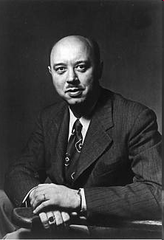
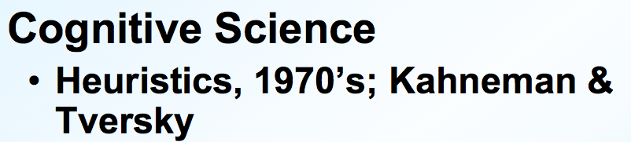

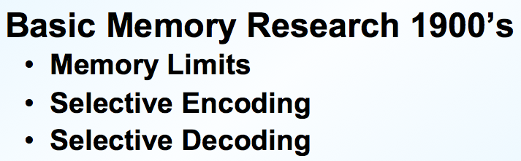
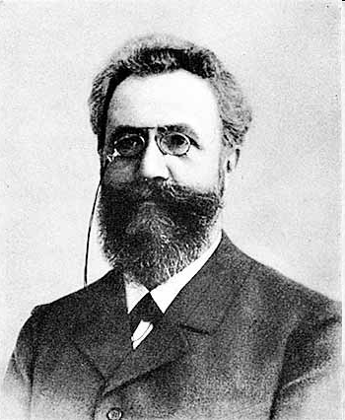
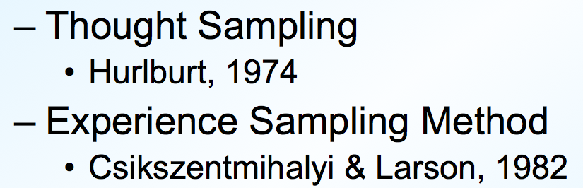
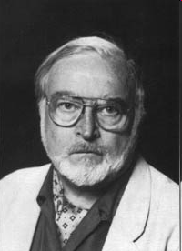
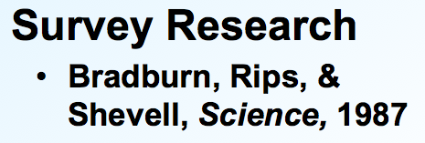


Why this talk now?
Intellectual Streams are rapidly merging
Ecological
Validity
mHealth
Quantified Self
Movement

Slide 4
Acknowledgement
…. of Prior Work
  Schwarz, N Retrospective and concurrent self-reports: The rationale for Real-Time Data Capture. In Stone, AA, Shiffman, S, Atienza, A, & Nebeling, L (Eds.) The Science of Real-Time Data Capture. Oxford University Press, 2007.
  Scollon, CN, Kim-Prieto, C, & Diener, E Experience Sampling: Promises and pitfalls, strengths and weaknesses. In Dioener, E (Ed.) In Assessing well-being: The collected works of Ed Diener, Social Indicators Research Series, 2009.
  Silvia, PJ, Kwapil, TR, Eddington, KM, & Brown, LH Missed beeps and missing data: Dispositional and situation predictors of nonresponse in Experience Sampling Research, Social Science Computer Review, 2013.
  Schneider, S & Stone, AA Ambulatory and diary methods can facilitate the measurement of patient-reported outcomes. Quality of Life Research, 2016.

Slide 5
Acknowledgement
…of Colleagues
USC Dornsife Center for Self Report Science
    Stefan Schneider, Ph.D.
    Joan Broderick, Ph.D.
    Doerte Junghaenel, Ph.D.
    Bob Ono, Ph.D.
    Marta Walentynowicz, Ph.D.
    Marcella May, M.A.
    Alicia Boulton, Ph.D.
    Ania Filus, Ph.D.
And elsewhere
    Joshua Smyth, Ph.D. at Penn State
    Joe Schwarz, Ph.D. at Stony Brook University

Slide 6



Before starting… my slight concern

Slide 7
Overview of Challenges and Opportunities
Challenges pertain to areas where knowledge is limited
  Some are based on lore or the cumulative experience of researchers
  Some are viewed as intractable
  Some are just overlooked
Selection of people and moments
Limits and meaning of momentary self-reports
Psychometrics
Qualitative approaches
“Fundamentals” of momentary reports over time
Moments or broader coverage?
Reactivity and motivation
Has RTDC for self-report lived up to its promise?
But first, a cross-cutting issue

Slide 8
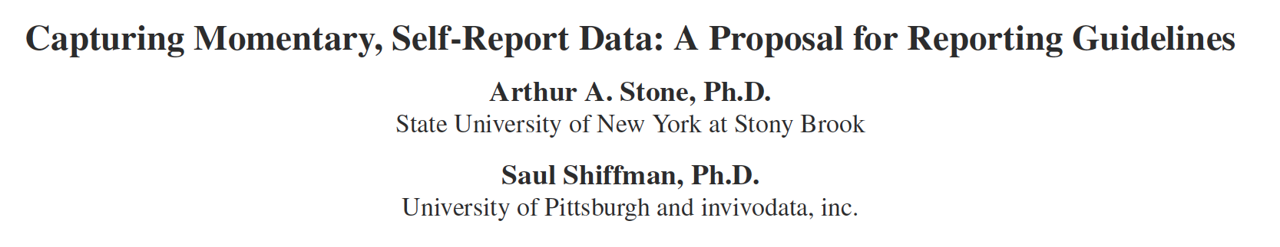
Cross-cutting issue of reporting
In many of the topics to come, it is difficult to know what was done in a study
  Two recent reviews of EMA/ESM in children and for measuring chronic pain
15 years old, we proposed reporting guidelines for real-time data collection
Turns out that this is especially important given the “replication crisis” in science, and particularly in social psychology
Importance of these recommendations – and of many of the points I’ll make throughout the presentation – depends on questions one is asking
  E.g., creating person-level variables versus examining within-person, momentary associations

Slide 9
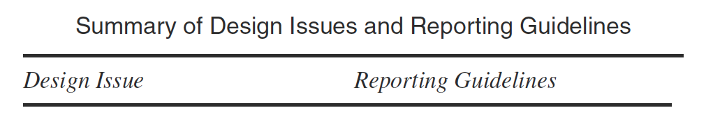
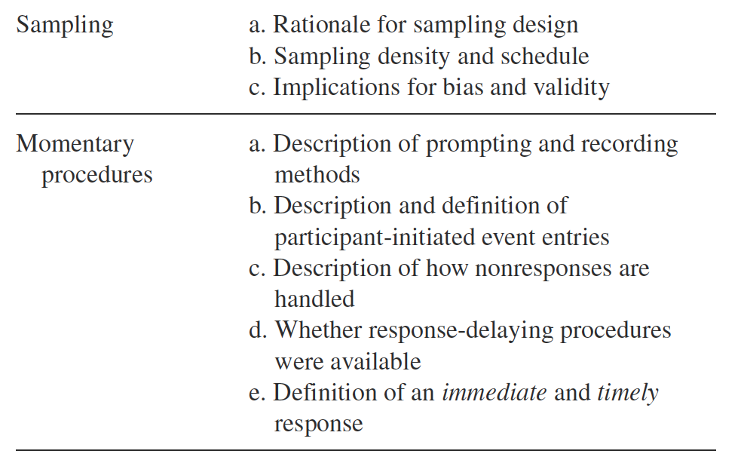
Cross-cutting issue of reporting

Slide 10
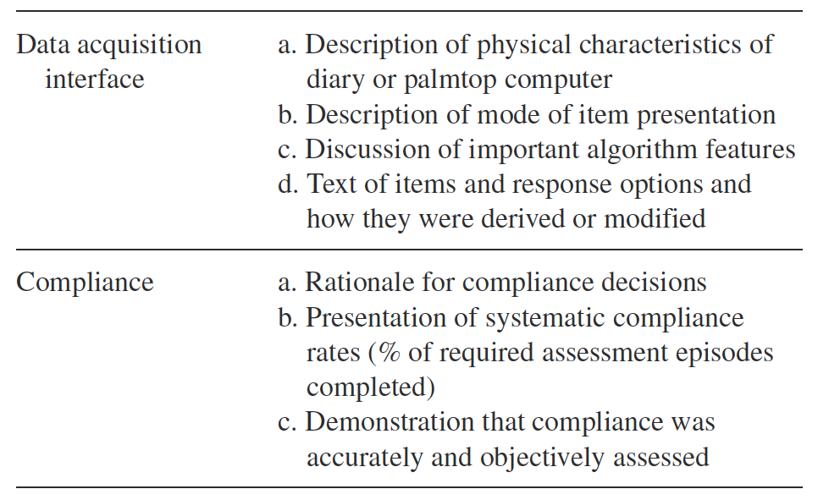
Cross-cutting issue of reporting

Slide 11
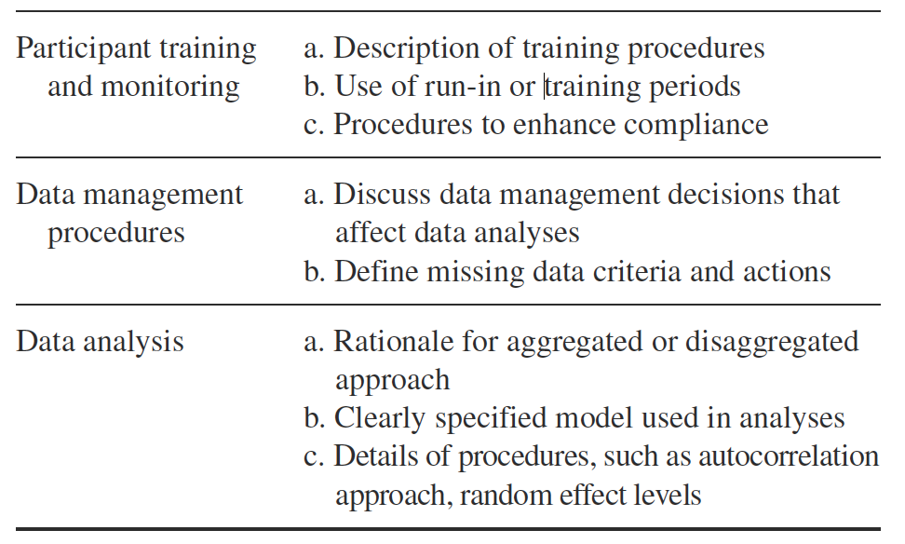
Cross-cutting issue of reporting

Slide 12
1. Selection of all kinds: People
The usual suspects -- difficult occupations/ circumstances/lives
Technological challenges – perhaps less relevant
We have no idea what EMA Study Uptake is like
  Guess: rather low, but with what biases?
Very little data on this topic as the following examples demonstrate:

Slide 13
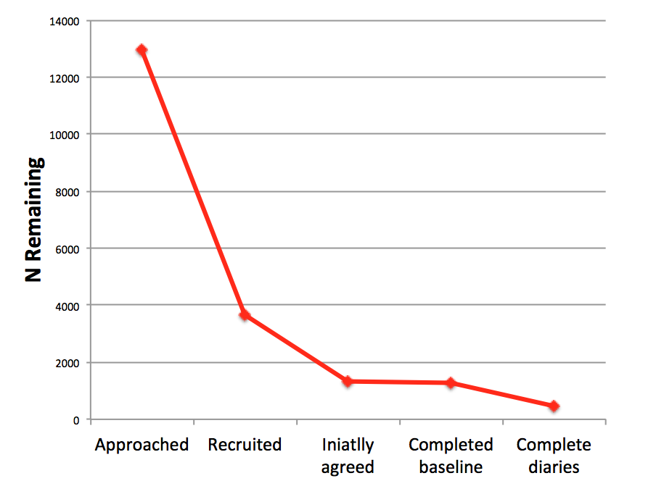
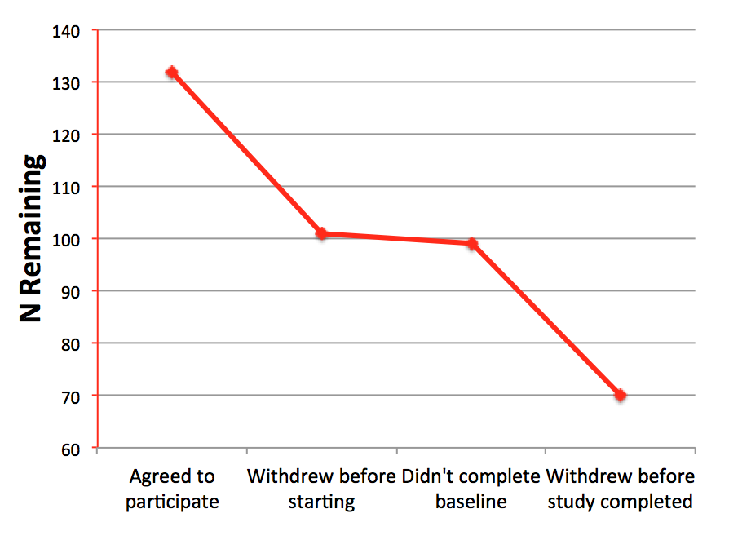
1. Selection of all kinds:
People
2014 Nicotine and Tobacco
Research article
2016 Stress and Health article
12,970
132
70
461

Slide 14
1. Selection of all kinds: Moments
The usual suspects
Recent reviews of EMA papers
  Review of psychiatric EMA studies: 13 of 40 studies, 33%, did not report completion rates (Cain et al., 2009)
  Our review of pain EMA studies, 31 of 104, 30%, did not report completion rates (May et al., in progress)
Computation of Completion rates
  Count everyone: Intention to Treat approach?
    Or toss those with bad data, and then compute completion rates?
  What about suspends, napping, “late” reports?
  Despite acceptable overall completion rates, studies sometimes include individuals with unacceptable completion rates

Slide 15
2. Momentary reporting may alter the reporting task
Duration of recall period impacts meaning of questions
  When information is not fully accessible, respondents may look to the question for guidance
  Main issue: Shorter recall periods suggest that more minor instances or intensities are sought
    So, minor arguments are reported; lesser affects
Secondary issue: Differences in the use of scale anchors
    “Moderate” in a brief recall period may mean less that “moderate” in a longer recall period
Tertiary issue: Growing Social Desirability as respondents learn about themselves (e.g., not liking their kids)

Slide 16

3. Psychometrics
Not clear why
Probably, the idea that because the information measured is apparently accessible, then there is little error to the measurement
Measurement properties need to be determined at a within-person basis
  E.g., Bolger’s 2006 approach to reliability

Slide 17
3. Psychometrics
Scales versus items
  Often EMA use single item assessments
  Relatively little data on increasing momentary reliability
    Should be large as items are added
  May be especially important for:
    Analyses of within-person associations
    Just in Time Interventions

Slide 18
3. Psychometrics
IRT approaches
  We know little/nothing about:
    The information functions (difficulty) of items of within-day items
    Calibration to a known sample
    Differential Item Function
  Such information could improve our ability to capture precise information in an efficient and reliable manner
  Computer Adaptive Testing in EMA
    An idea that should be implemented

Slide 19
3. Psychometrics
Momentary Context effects
  A ubiquitous though often overlooked issue concerns item context effects
  Two types of Context:
    The impact of situation/environment – primary goal
    Item-order context effects
  Item-order context: Not only main effects of context questions, but potential interactive effects with group membership
  No information about if this occurs in EMA
  Implications: more thoughtful arrangement of questions according to content accessibility (on idea that low accessibility is more susceptible to context effects)

Slide 20
4. Relative absence of Qualitative Approaches
“Usability” testing is often done, but that’s different
Qualitative techniques have the potential to elucidate the cognitive processes associated with EMA
  Interpretation of questions
  Interpretation of instructions (e.g., reporting period)
  Possible discovery of new response outcomes (e.g., contextual factors)
Possibility of Real-time qualitative work

Slide 21
5. Some fundamentals poorly understood
Similar to the Psychometric point, it isn’t clear that we have exhausted our understanding of “fundamentals” of EMA data
What’s happening in the first few days of recording when average outcome levels often decline?
  Some folks suggest throwing out those days
  Others ignore
Regarding participant burden, the interplay of Assessment Duration, # of Prompts, and # of Days
  We do not know the calculus

Slide 22
5. Some fundamentals poorly understood
However, there may be a U-shaped function regarding burden and completion over time as suggested by Silva et al., 2013
And perhaps more dense prompting schedules yield better completion rates, also suggested by Silva et al., 2013
And there is another phenomenon that I believe is less well-know and understood: the decline in variability over time
  In EMA and in EOD
  Some data….

Slide 23
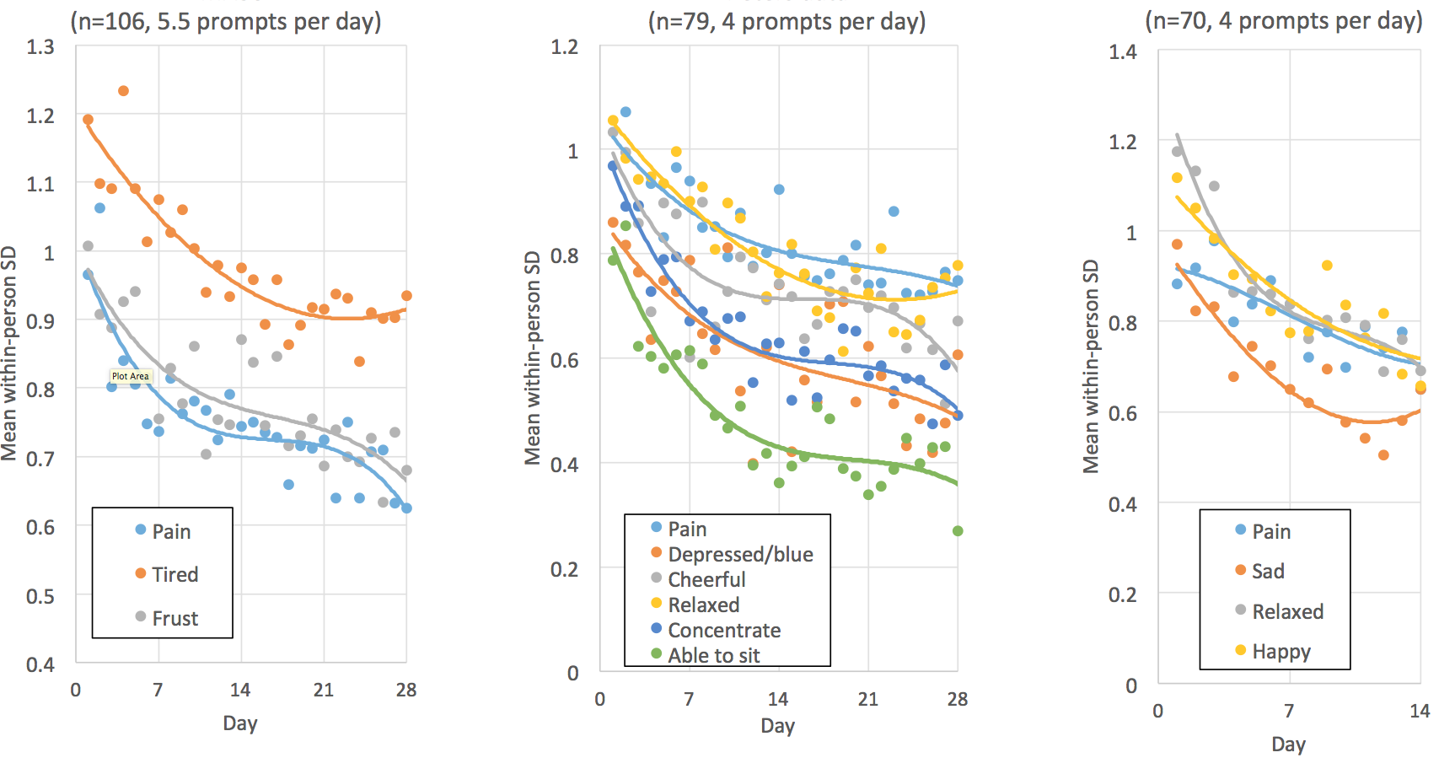
5. Some fundamentals poorly understood
Schneider, S. Within-person variability diminishes over time in intensive longitudinal assessment studies. Working Paper.

Slide 24
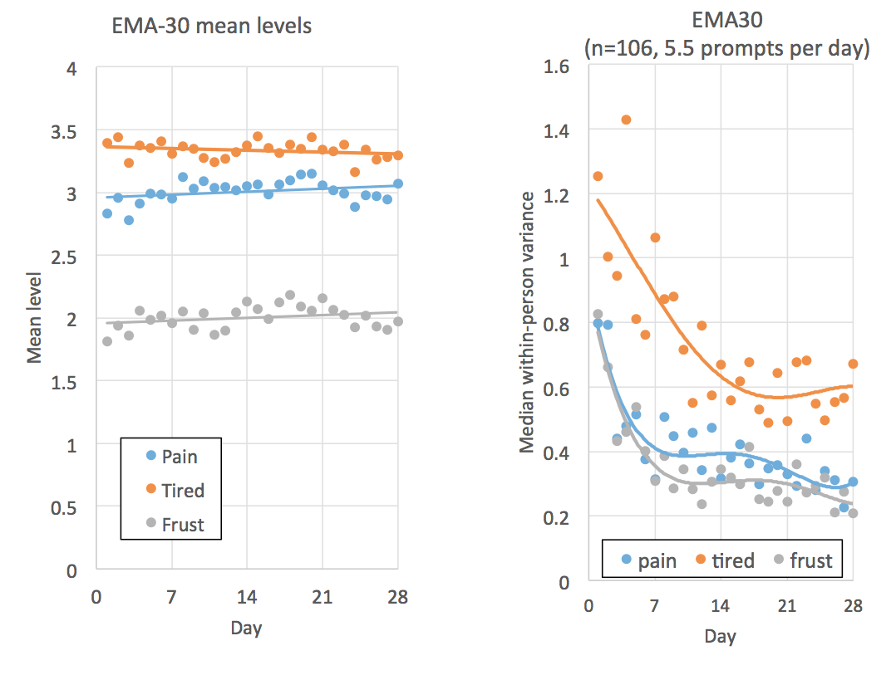
5. Some fundamentals poorly understood
Schneider, S. Within-person variability diminishes over time in intensive longitudinal assessment studies. Working Paper.

Slide 25
6. Moments or broader coverage?
Of 62 EMA projects with chronic pain patients, 24.2% (15 projects) did not report the time reference (e.g., “when prompted” or “in the last X hours”) of their pain item
Of the rest, the majority of them used the “momentary” time reference as compared to the “coverage” one
“Coverage” time reference:
  In the past 30 min: 3 projects
  During the last 2-3 hours: 1 project
  In the past 3 hours: 1 project
  Since the previous prompt (~240min): 1 project

Slide 26
7. Reactivity
Prevalent view is that reactivity is not very important
However, there is a nagging question about Self-Monitoring having salutary effects when used as a treatment modality
  This goes to respondent motivation underlying RTDC
There are other person-factors that have not been empirically examined

Slide 27
8. Has RTDC for Self-report lived up to its promise?
What’s the promise?
First, to provide a means of gathering granular, ecologically valid momentary reports of experience
  YES – though there are clearly questions about representativeness of respondents and moments
Second, to provide an alternative to recall data that is relatively free of bias
  PARTIALLY – there are very few studies that explicitly show reduced bias or improved construct validity when aggregated RTDC is compared with traditional recall measures

Slide 28
Conclusions
ESM/EMA/RTDC/AA methods have become more prevalent and accepted in social science and medical research over the last several decades
Much methodologic and analytic progress has been made over the same period
I have reviewed several topics that, in my opinion, need additional attention
And I hope in a very small way that this presentation inspires such work

